Slide 1
XBID Overview
SWE IG Meeting
Paris, CRE
07.04.2014
Supported by

Slide 2
Agenda
Project structure and interfaces
High level overview of current project status
XBID Joint project approach
High level PX project plan with DBAG
Early Start Agreement Step 1 – Overview & Timeline
Update on Shipping and Nomination
Summary and discussion

Slide 3
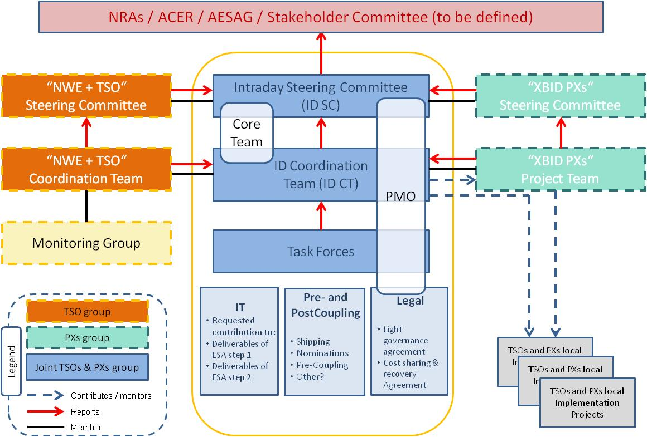
Project structure and interfaces

Slide 4
High level overview of current status (1)
Cost recovery
Letter of Cost Comfort has been received by PXs and TSO’s; it confirms 100% recovery of allowed costs subject to conditions. ‘NWE+’ TSOs have confirmed their agreement to the ‘NWE+’ PX’s.
PXs’ Cooperation Agreement (PCA)
Agreement has been reached between the PX’s to enable the Agreement with DBAG to be signed
PX/TSO Joint Project
Project Management Core Team established – program management coordination reflecting the Joint Project, PXs and TSOs. Core team meets weekly and reviews high level issues and resolution.
Joint Steering Group, Co-ordination Team and 3 Task Forces (Legal, IT and Pre & Post Coupling) are in place with members from both PX’s and TSO’s present in each

Slide 5
High level overview of current status (2)
Delivery of Early Start Agreement (ESA) Step 1
Progress has been made to complete this phase which defines the content of the solution to be developed
Investment in this phase provides the foundation for all parties
We are tackling challenging issues which are essential for the long term success of the project but which are taking time to resolve. These include:
Equal Treatment
Performance
Testing
We have a plan to complete ESA Step 1 by Easter which remains a challenge. We have an approach to close open issues if any remain at this point
Initial ideas have been shared on developing the future model for shipping and nomination

Slide 6
XBID Joint project approach
Design Local /regional Implementation projects (LIPs)
Local /Regional Implementation Projects
Roadmap interim Solution
LIPs framework conditions satisfied
Roadmap info from LIPs
Common framework for pre- and postcoupling
Follow-up/coordinate implementation of
Interim Solution
Coordinate Design and Development of Interim Solution
(monitoring and directing)
D&D contract
Business Blueprint
XBID Interim Solution delivered and accepted
Project under ESA
Project under contract

Slide 7
High level PX project plan with DBAG
6 weeks
4 months
1 year (depends on the project planning in ESA Step 1)
ESA Signature
Project under ESA
Project under Contract
ESA Step 1
ESA Step 2
Activities
Project Planning (for ESA Step 2 onwards)
Quality planning
Design and Development
Business Blueprint
FAT & IAT
UAT
Development and infrastructure
D&D Contract Negotiation
Maintenance Contract Negotiation

Slide 8
Early Start Agreement Step 1 - Overview
Description of ESA deliverables:
Delivery Prior Step 1
Specification of basic principles on project documentation (e.g. documentation management)
Delivery 1
Project terms and principles of equal treatment
Delivery 3 Batch 1
Project management principles for handling of issues, changes, risks and communication
Delivery 3 Batch 2
Project and quality planning, definition of the work products, test strategy
Notes:
Audience: TSOs, NRAs, ACER, ….

Slide 9
Early Start Agreement Step 1 - Timeline
17.1.2014
02.04.14
Commence ESA Step 2
ESA Step 1
Delivery Prior Step 1
Decision on ESA Step 2
Stakeholder Review &Confirmation
Lessons Learnt Review
Mobilisation ESA Step 2
Comfort Letter issued
Delivery 1
Delivery 3 Batch 1
ESA validation by Vendor board
Delivery 3 Batch 2
ESA validation by PX boards
ESA ready to be signed
ESA signed
PCA - SC approval of 2nd step assessment
PCA ready to be signed
PCA signed
Beginning
May14
24.1.14
3.2.14
13.2.14
15.04.14
- Delay with significant impact
- Completed
- Date
Notes:
Audience: TSOs, NRAs, ACER, ….

Slide 10
Update on Shipping and Nomination
An Intraday continuous capacity allocation market imposes far more challenging requirements to the shipping and nomination process than for the Day Ahead (DA) market
Cross-border allocation settlement processes must be concluded within a short period before real time to facilitate the short gate closure times
This requires high robustness of the TSO operational processes to conclude the cross-border capacity allocation settlement into the required schedules (e.g. for controlled devices: load frequency controllers, phase shifters & DC cable flows)
The two options on cross-border nomination are being evaluated
1) Border to border and 2) Hub to hub
TSO’s perspective: The existing DA solutions for shipping and nomination will have limited geographic scope for the scale of implementation required to facilitate an orderly Intraday market on a pan-European scale. A hub to hub approach may be necessary.
4 aggregation options of functions for shipping and nomination have been identified for the above 2 options, which gives a total of 8 potential options to be evaluated
Joint assessment of a potential centralised solution and the governance implications needs to completed. High level scoring on quality, costs, implementation time and future proofing has started at a working level and will be progressed over the coming weeks. There are resource constraints at present due to the priority on completing ESA Step 1
Full resolution of this topic is needed before start of LIPs. The immediate need, so as to ensure that the blueprint phase is not delayed, is to look at functional implications, if any, with an impact on the XBID system.
Notes:
Limitation of geographical scope

Slide 11
Summary and discussion
Whilst progress has been made with ESA Step 1 the process and complexity, together with challenges of reaching alignment have been significant. All parties are striving to resolve key issues rather than allowing these to cause subsequent project delays
These key issues involve Equal Treatment, Performance and Testing
The extension of ESA Step 1 has involved additional cost
All parties are targetting completion of ESA Step 1 by Easter which remains a challenge. There is a plan to allow a short period to ensure full agreement to Step 1 (including as necessary with NRAs) before starting Step 2. This also allows for a “lessons learnt project review” to improve processes
It is expected that a period of around 12-13 months will be required to deliver the XBID solution. It is essential that aspects such as Integration Testing are included to ensure robust implementation.
Agreeing the future model for shipping and nominations is key. The different options being considered have varying impacts on implementation timescales, the costs of the solution and scalability.
Development of the Local Implementation Projects (LIPs) and roadmap is to be undertaken once the Business Blueprint phase is completed. Where possible and subject to confirmation LIP implementation will be run in parallel with the XBID solution project

